Slide 1


Slide 2


Datasets y Datawarehousing

Slide 3
🐱‍💻Objetivos de aprendizaje🐱‍💻

Slide 4
Objetivos de aprendizaje🐱‍💻
Empezaremos estudiando🐱‍💻 la presentación llamada Creando un Data Warehouse y datasets limpios🤖💜 donde haremos un breve repaso a las mejores prácticas y herramientas para limpieza de datos, creación de datasets y data warehousing📊💜.
Después, vamos a ver algunos ejercicios prácticos de creación y limpieza de datasets📊💜 en un par de Python Notebooks💻🐍 para seguir practicando🐱‍💻 nuestras habilidades de programación con Python.
Por último, haremos un challenge🐱‍💻 de exploración de datasets📊💜 usando BigQuery + Cloud DataLab🤖💜 en QwikLabs.

Slide 5
Agenda
6:30 - 6:35 PM Saludos y anuncios.
6:35 - 6:40 PM Objetivos de aprendizaje.
6:40 - 7:40 PM Presentación: Creando un Data Warehouse y datasets limpios.
7:40 - 8:10 PM Notebooks: Creación y limpieza de datasets.
8:10 - 8:25 PM BREAK.
8:25 - 9:20 PM Notebook+Challenge: BigQuery + Cloud Datalab.
9:20 - 9:30 PM Conclusiones.

Slide 6

Agenda
0. Datasets y Data Warehousing en Data Engineering
1. Creando un Data Warehouse
2. Herramientas para crear un dataset:
Tutorial de Faker para seeding de datos
Creando un dataset desde cero
3. Challenge: Big Query + Cloud Datalab

Slide 7
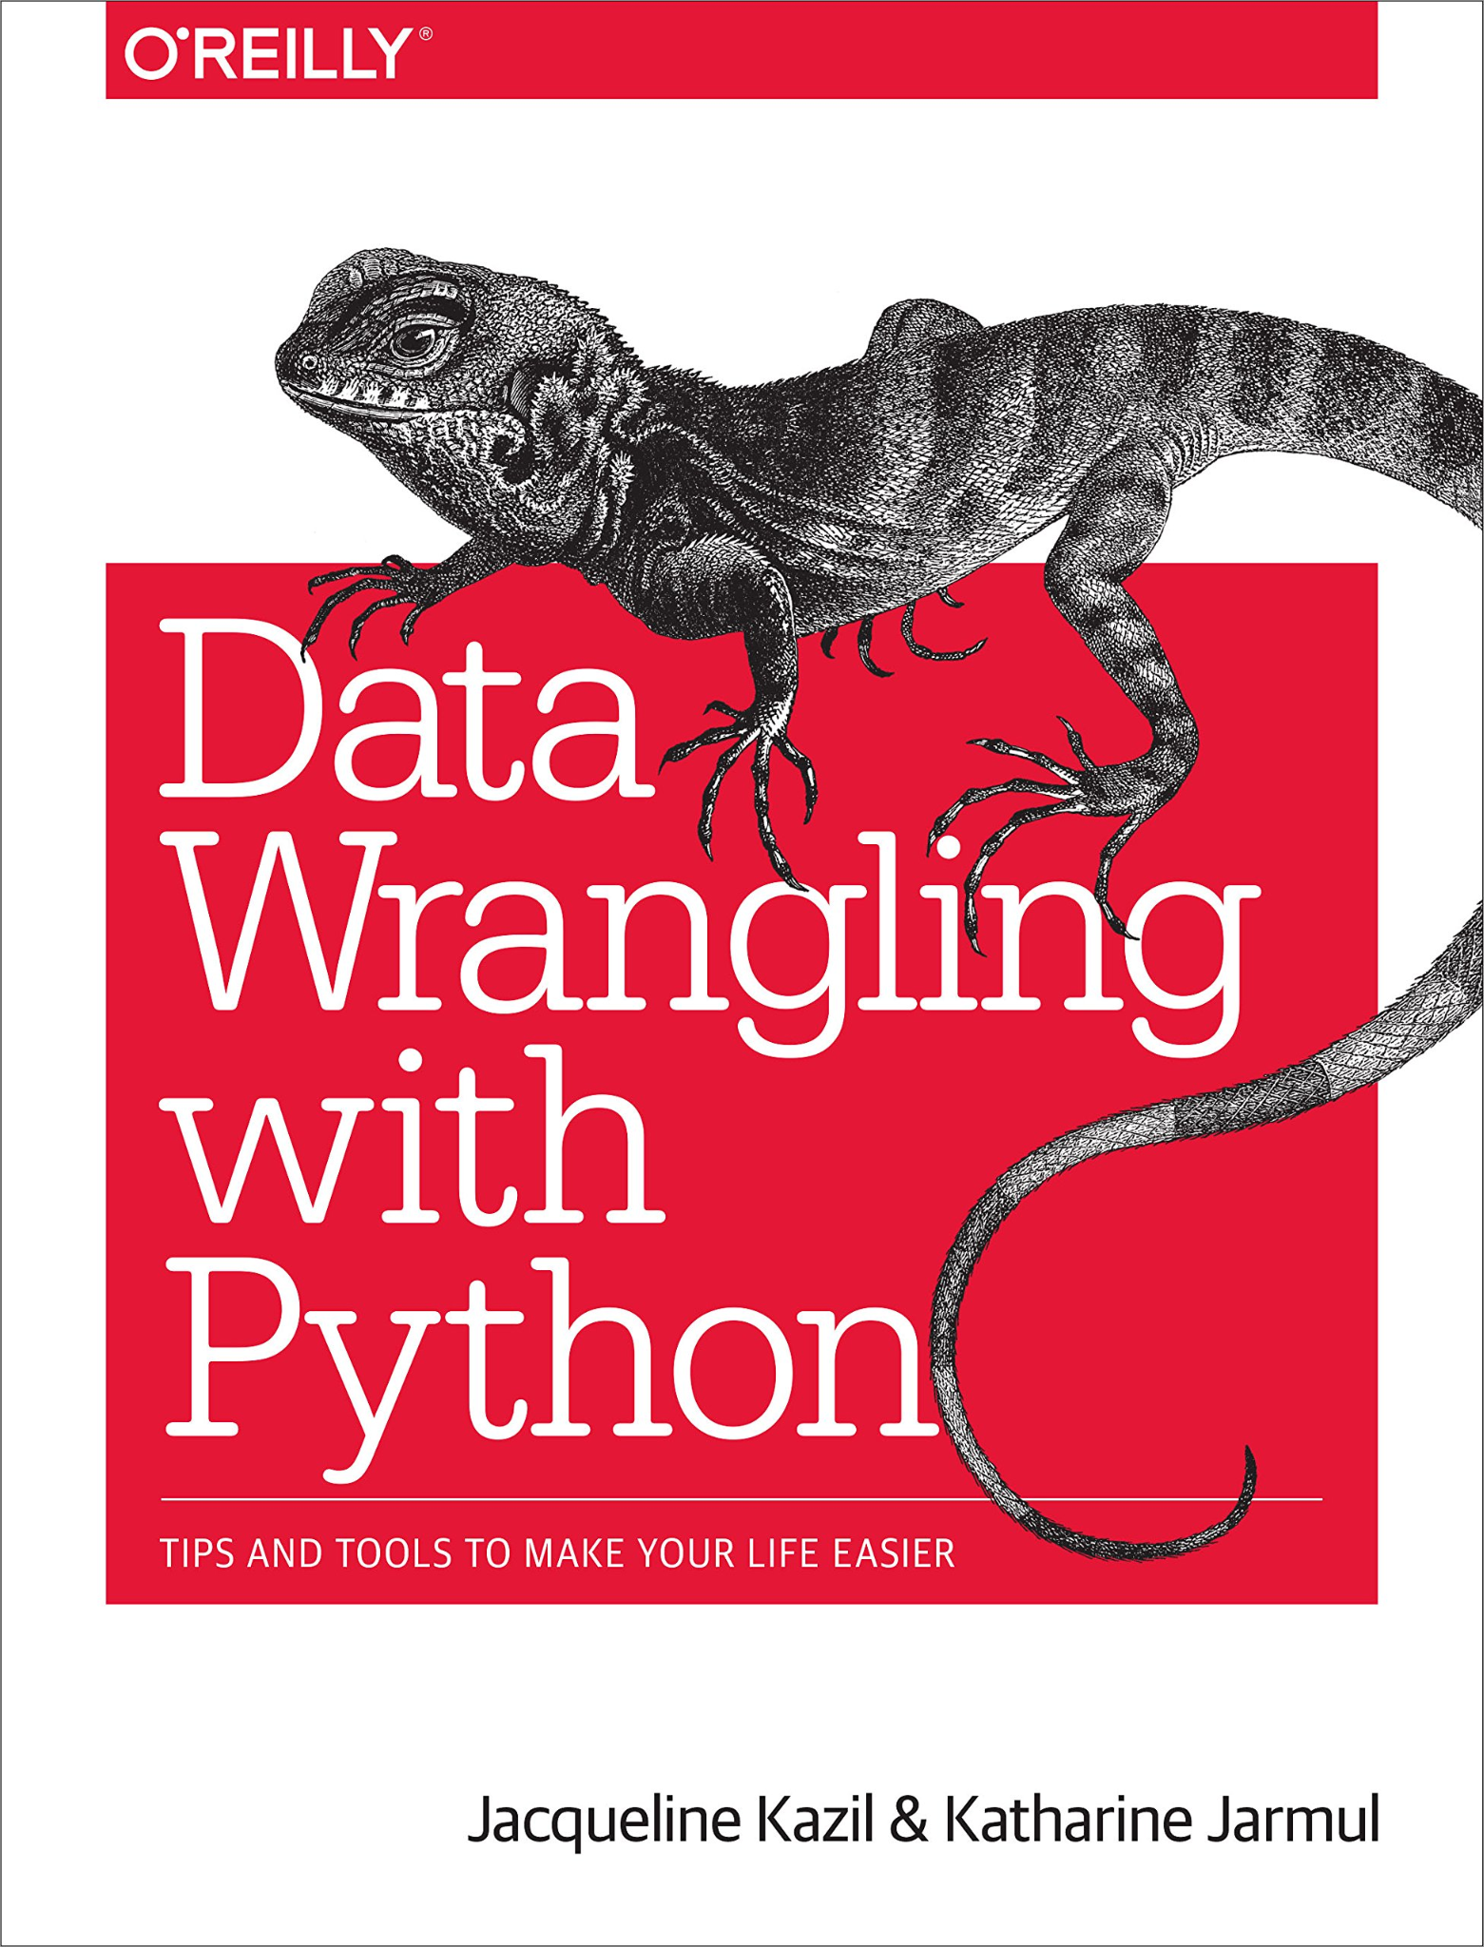
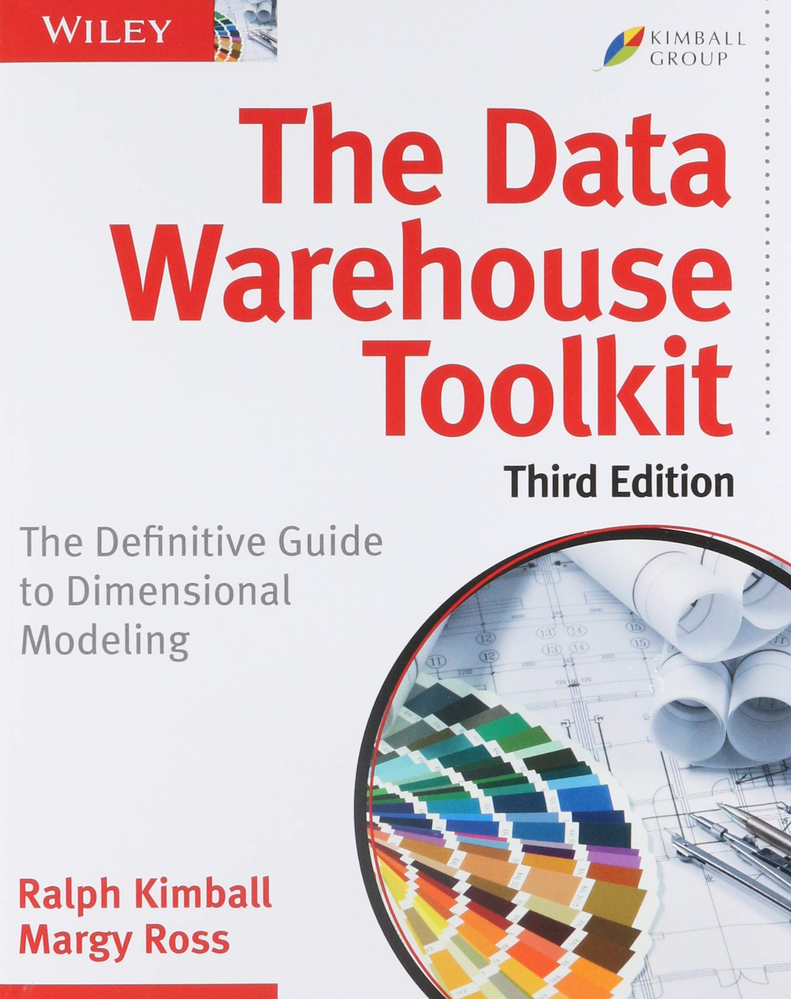
Recursos y meta-recursos para estudiar
The Data Warehouse toolkit.
Ralph Kimball y Margy Ross.

Slide 8

Recursos y meta-recursos para estudiar
Especialización: Machine Learning Avanzado en Google Cloud

Slide 9
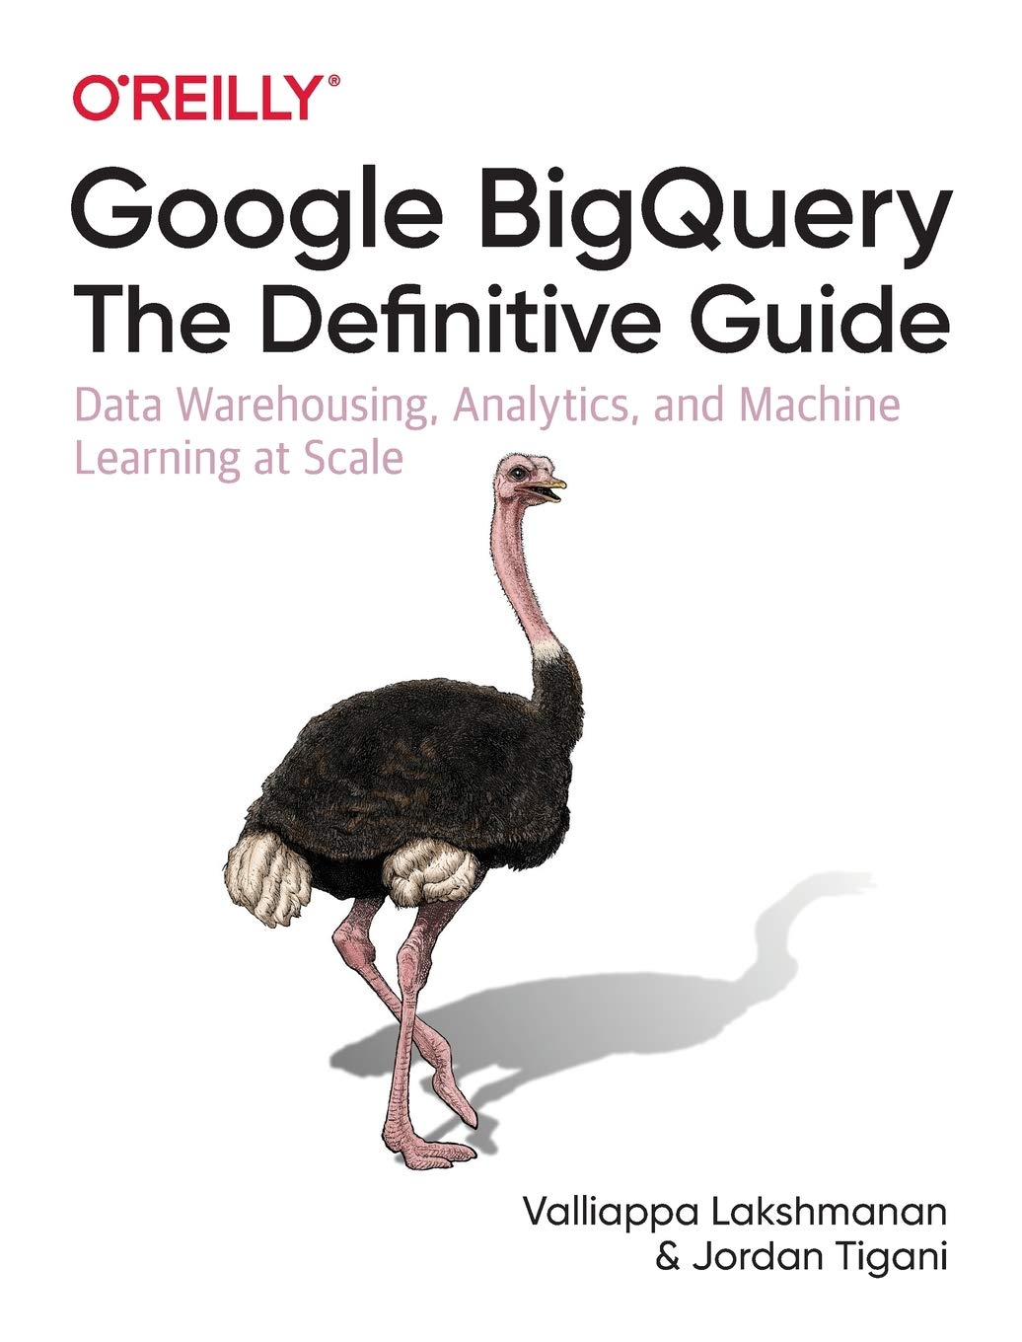
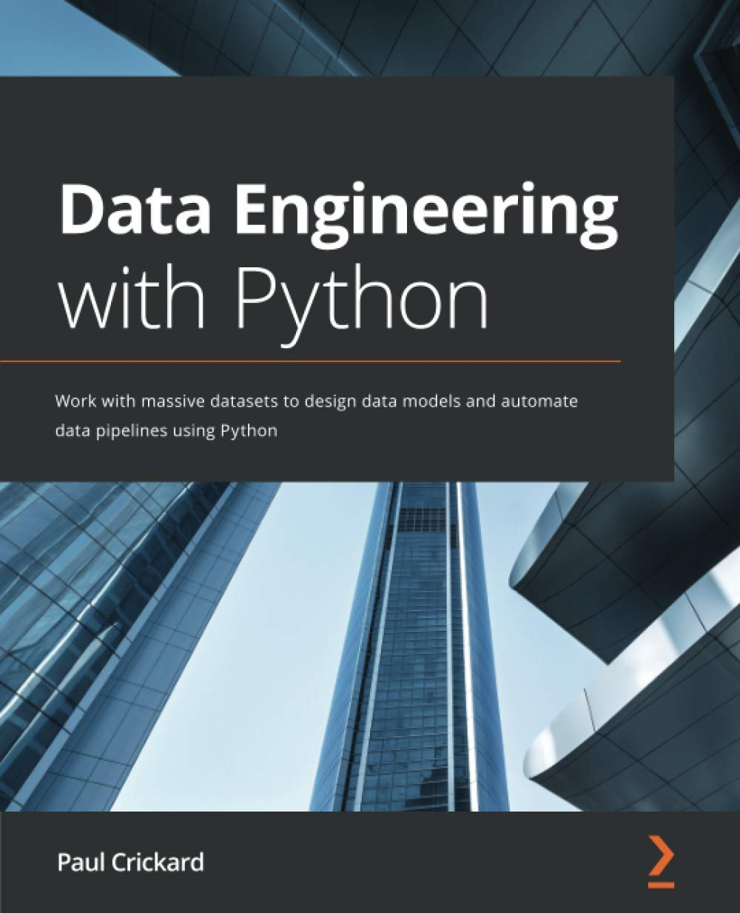
Recursos y meta-recursos para estudiar
Google BigQuery The definitive guide.

Slide 10
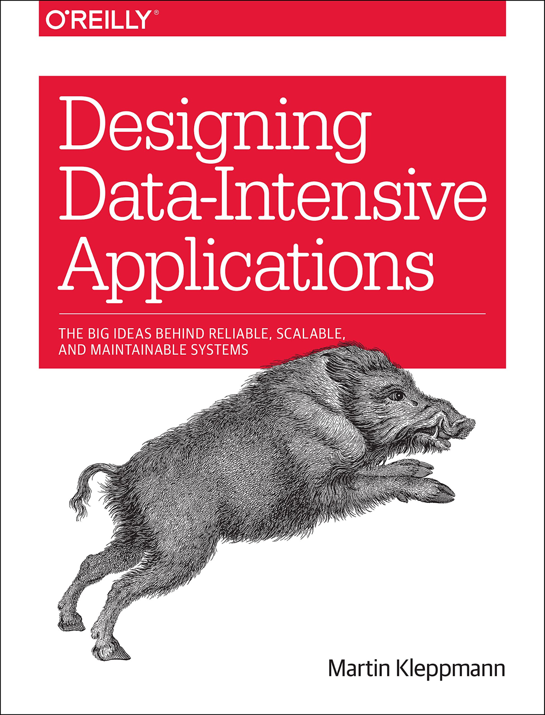
Recursos y meta-recursos para estudiar
Designing Data-Intensive Applications.
Mike Kleppmann

Slide 11
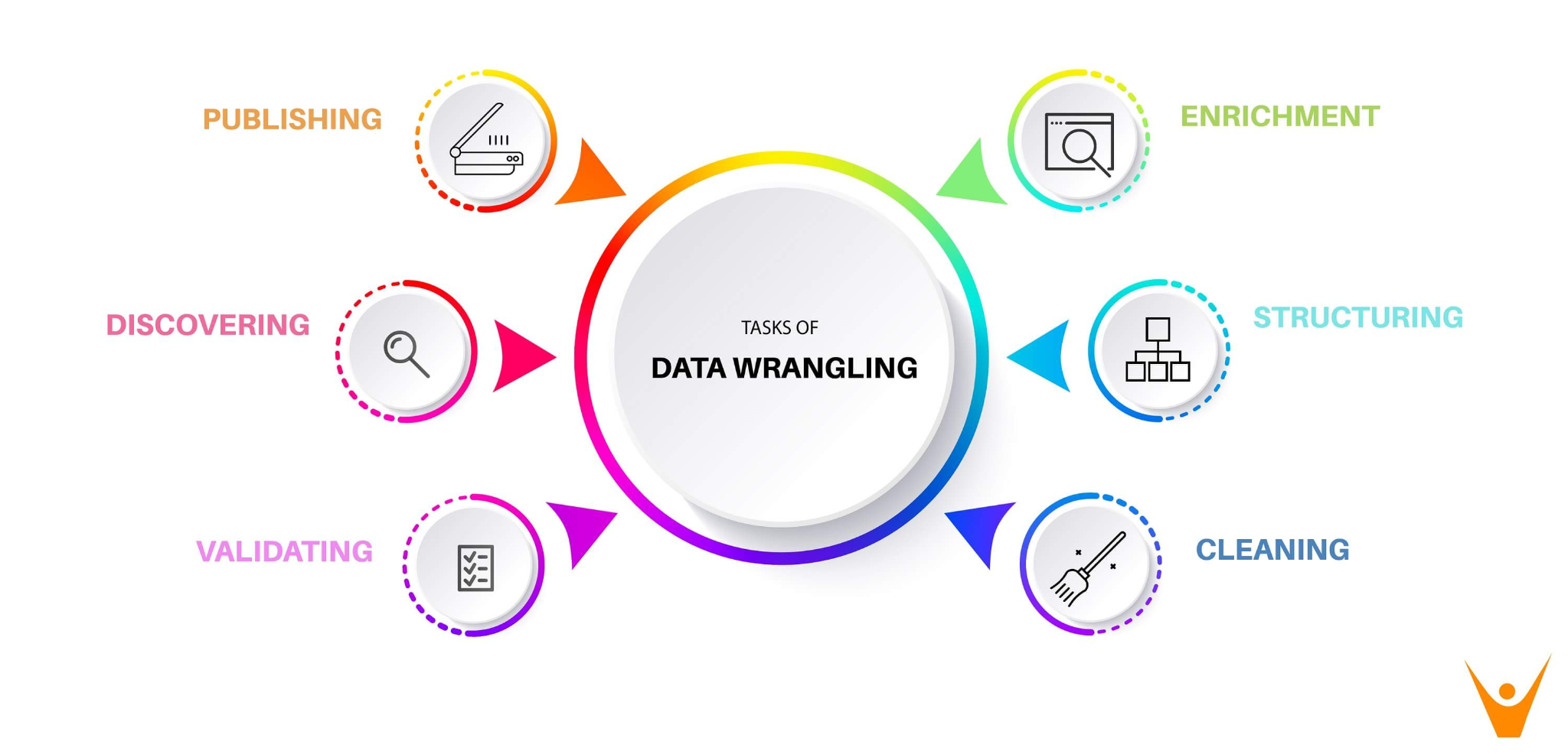
¿En qué etapa nos encontramos?
Descubrimiento.
Estructura.
Limpieza.
Enriquecimiento.
Validación.
Publicación.

Slide 12
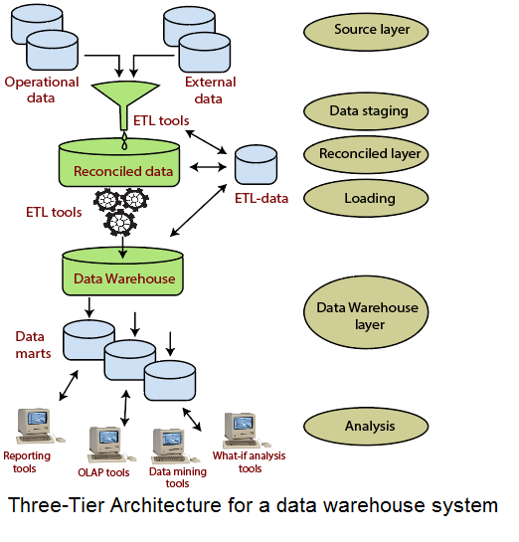
Creando un Data Warehouse y datasets limpios.
Data Sources
Data Lakes
Data Warehouse
Data Marts
Notes:
A data source may be the initial location where data is born or where physical information is first digitized, however even the most refined data may serve as a source, as long as another process accesses and utilizes it. Concretely, a data source may be a database, a flat file, live measurements from physical devices, scraped web data, or any of the myriad static and streaming data services which abound across the internet.
A data lake is a centralized repository that allows you to store all your structured and unstructured data at any scale. You can store your data as-is, without having to first structure the data, and run different types of analytics—from dashboards and visualizations to big data processing, real-time analytics, and machine learning to guide better decisions.
A data warehouse is a type of data management system that is designed to enable and support business intelligence (BI) activities, especially analytics. Data warehouses are solely intended to perform queries and analysis and often contain large amounts of historical data. The data within a data warehouse is usually derived from a wide range of sources such as application log files and transaction applications.
A data mart is a subset of a data warehouse focused on a particular line of business, department, or subject area. Data marts make specific data available to a defined group of users, which allows those users to quickly access critical insights without wasting time searching through an entire data warehouse. For example, many companies may have a data mart that aligns with a specific department in the business, such as finance, sales, or marketing
https://towardsdatascience.com/how-to-build-a-data-set-for-your-machine-learning-project-5b3b871881ac
https://www.analyticsvidhya.com/blog/2018/11/data-engineer-comprehensive-list-resources-get-started/

Slide 13
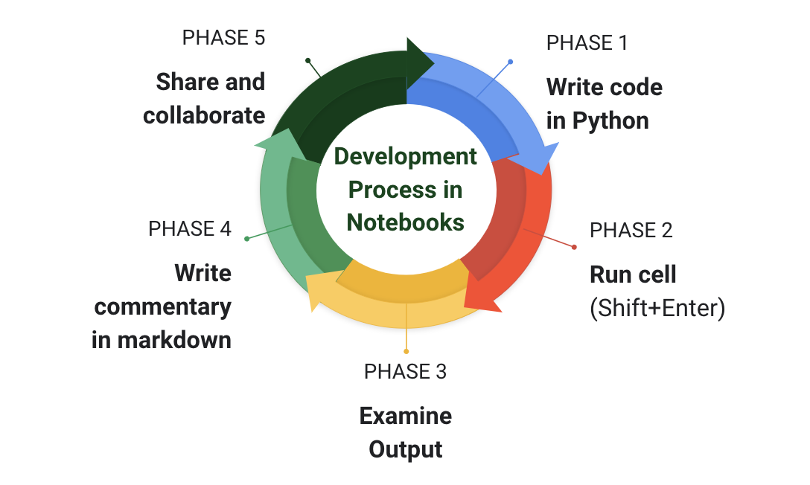
Web scrapping con TF+BigQuery+Notebooks
Descubrimiento.
Estructura.
Limpieza.
Enriquecimiento.
Validación.
Publicación.
Notes:
https://towardsdatascience.com/data-wrangling-raw-to-clean-transformation-b30a27bf4b3b

Slide 14
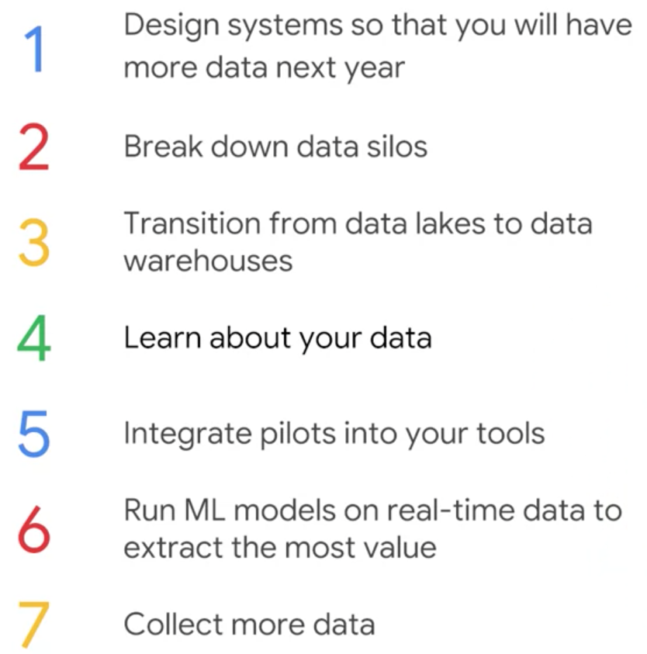
Estrategia de datos:
Notes:
https://landing.ai/ai-transformation-playbook/

Slide 15
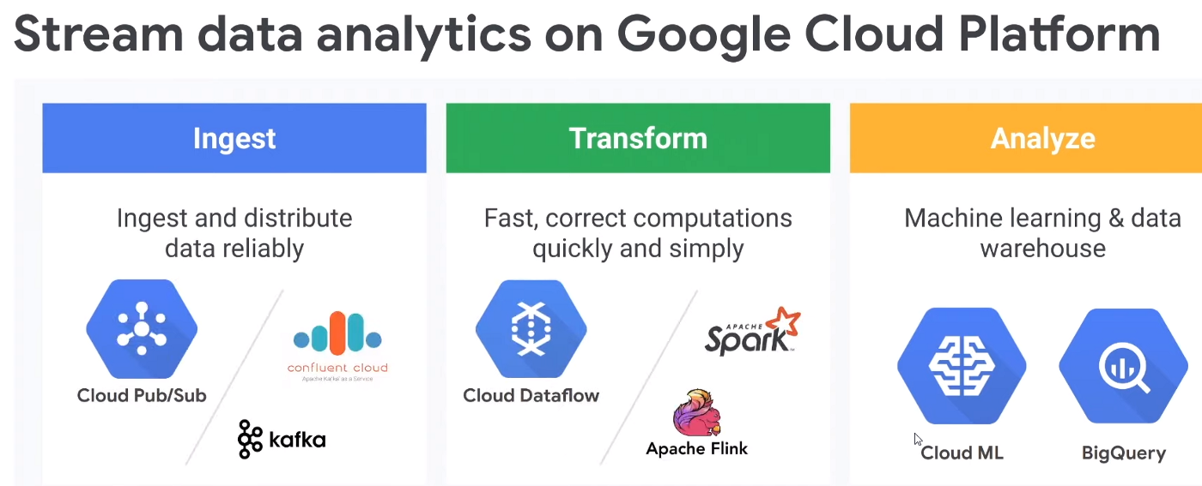
Diagrama de componentes GCP
Notes:
Apache Kafka is an open-source distributed event streaming platform used by thousands of companies for high-performance data pipelines, streaming analytics, data integration, and mission-critical applications.

Slide 16
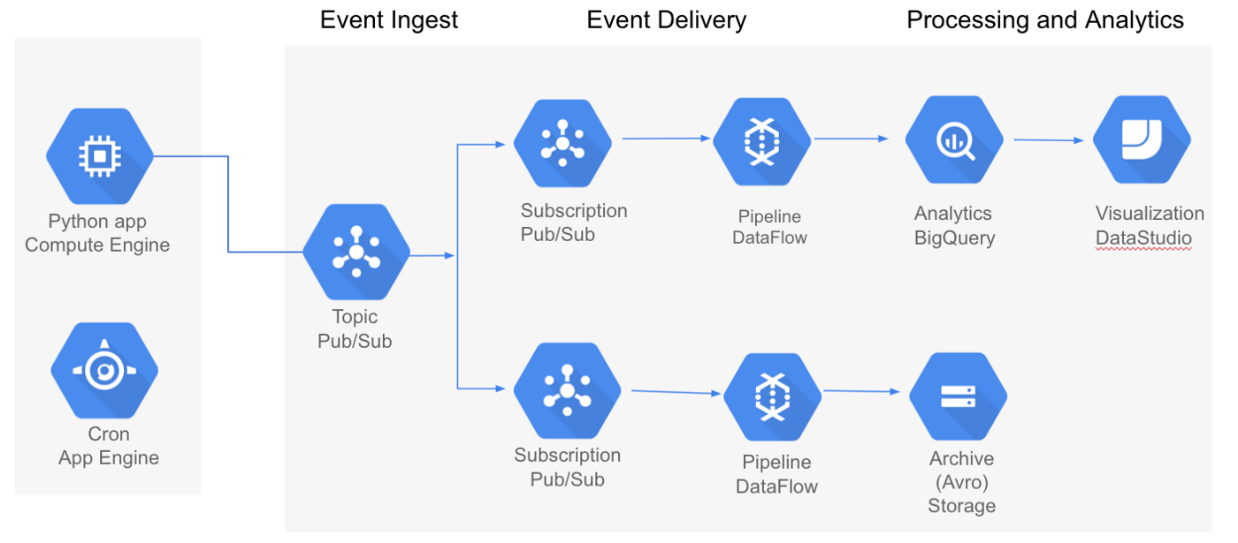
Vista de ave: Arquitectura de un proyecto en GCP

Slide 17
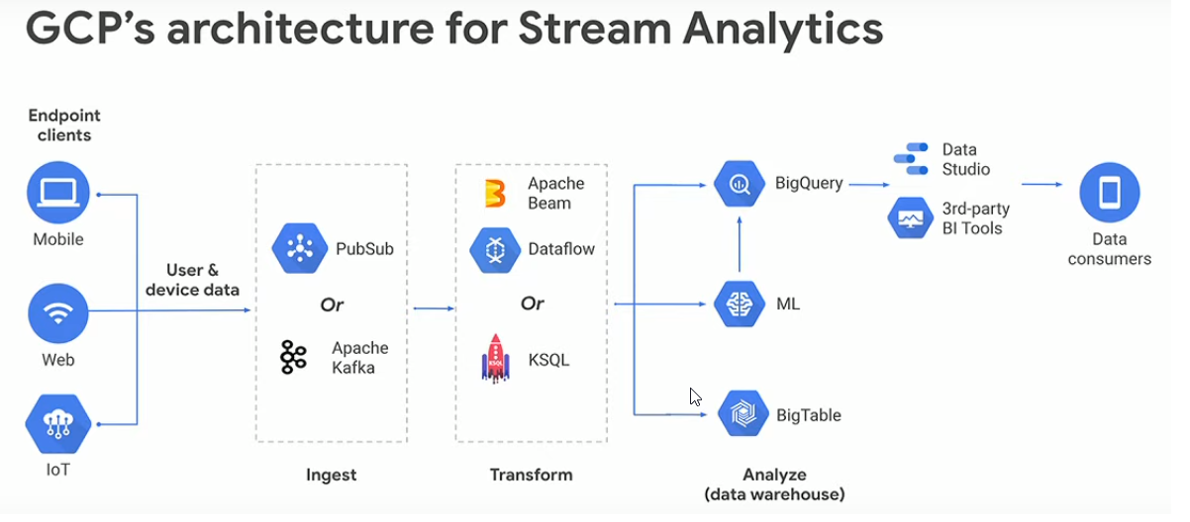
Diagrama de componentes GCP
Notes:
Apache Kafka is an open-source distributed event streaming platform used by thousands of companies for high-performance data pipelines, streaming analytics, data integration, and mission-critical applications.
Apache Beam is an open source unified programming model to define and execute data processing pipelines, including ETL, batch and stream processing.
KSQL is the database purpose-built for stream processing applications.

Slide 18
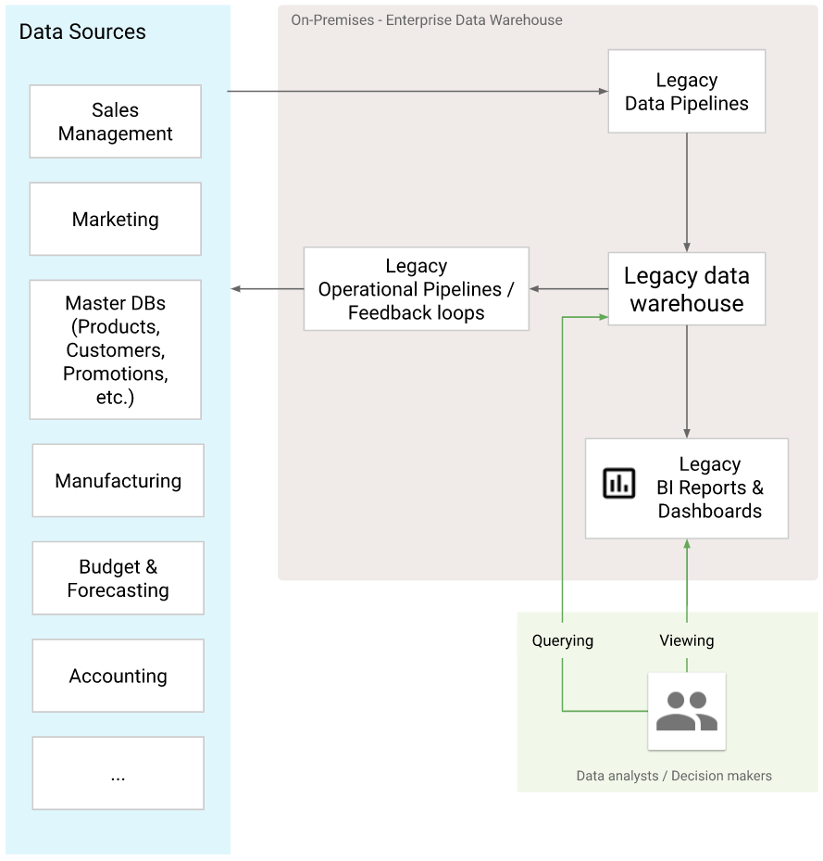
Vista de ave: Caso de negocio

Slide 19
Creando un Data warehouse.

Slide 20
¿Qué es un dataset?
Un dataset es una colección de datos. En el caso de datos tabulares, un dataset corresponde a una o más tablas de una base de datos, donde cada columna de la tabla representa una variable particular, y cada fila corresponde a una observación del conjunto de datos en cuestión.

Slide 21
¿Qué es un data warehouse?
Un Data Warehouse es un sistema de bases de datos relacional (RDBMS) diseñado para cumplir con una alta cantidad de consultas y análisis en vez de optimizar para la velocidad de procesamiento de transacciones. Puede incluir datos históricos derivados dentro de la organización o de múltiples fuentes.
Por su naturaleza, un Data Warehouse provee datos históricos integrados de diversos departamentos operativos y se enfoca en proveer conocimiento y soporte para que los tomadores de decisiones puedan hacer modelado y análisis.
Notes:
https://www.javatpoint.com/data-warehouse

Slide 22
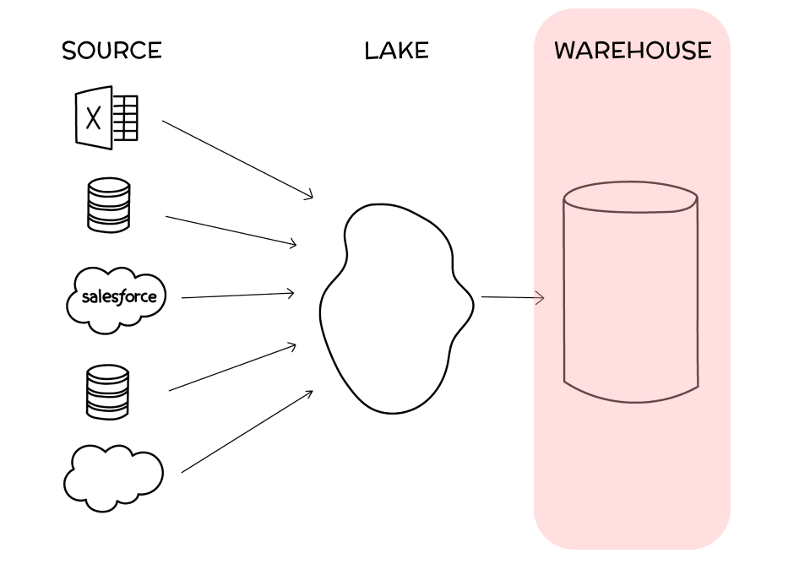
Data warehouse: Vista general
Notes:
https://www.javatpoint.com/data-warehouse

Slide 23
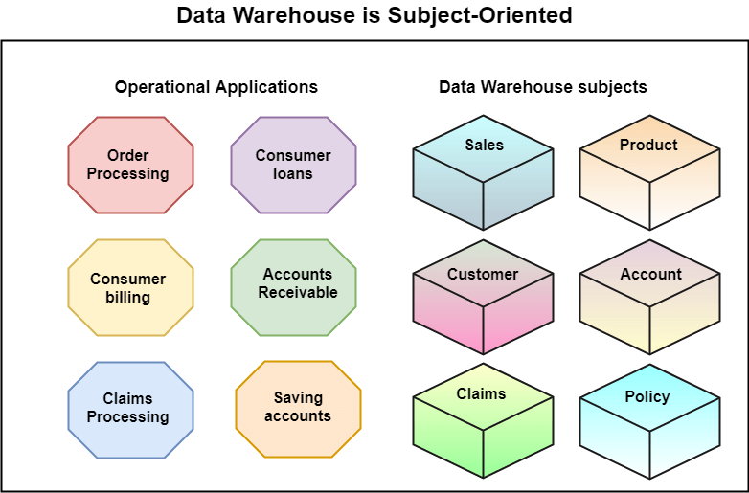
Data warehouse: Orientado a temas
Notes:
https://www.javatpoint.com/data-warehouse

Slide 24
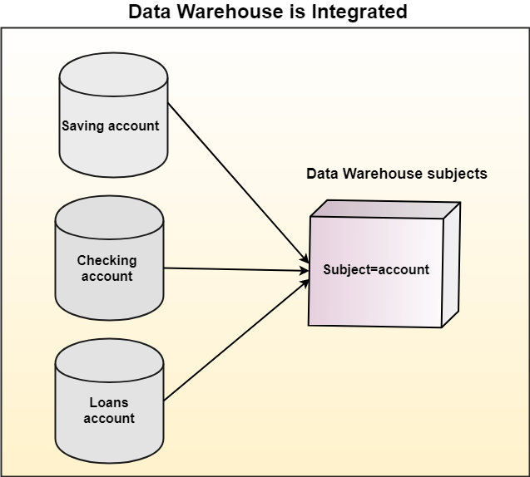
Data warehouse: De alta integración
Notes:
https://www.javatpoint.com/data-warehouse

Slide 25
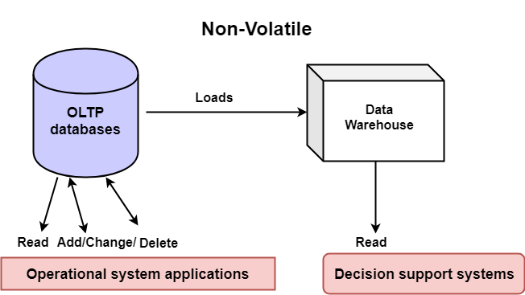
Data warehouse: No-volátil
Notes:
OLTP (online transactional processing) enables the rapid, accurate data processing behind ATMs and online banking, cash registers and ecommerce, and scores of other services we interact with each day.
OLTP, or online transactional processing, enables the real-time execution of large numbers of database transactions by large numbers of people, typically over the internet.
A database transaction is a change, insertion, deletion, or query of data in a database. OLTP systems (and the database transactions they enable) drive many of the financial transactions we make every day, including online banking and ATM transactions, e-commerce and in-store purchases, and hotel and airline bookings, to name a very few.
https://www.javatpoint.com/data-warehouse

Slide 26



Herramientas para crear un dataset y data warehouse.
Notes:
https://dataschool.com/data-governance/introduction-to-modern-data-governance/

Slide 27
Tutorial de Faker
Exploremos el siguiente recurso:
¡Click acá!
Notes:
https://analyticsindiamag.com/faker-tutorial-a-python-library-to-create-your-own-dataset/
https://www.geeksforgeeks.org/python-faker-library/

Slide 28
Creando un dataset desde 0
Exploremos el siguiente recurso:
¡Click acá!
Notes:
https://towardsdatascience.com/how-to-create-a-machine-learning-dataset-from-scratch-6a24a9fd1673
https://github.com/akcarsten/cook_book/blob/master/01_create_first_dataset.ipynb

Slide 29
Hoja de trucos para limpieza en Python
Exploremos el siguiente recurso:
¡Click acá!
Notes:
https://towardsdatascience.com/a-checklist-for-data-wrangling-8f106c093fef

Slide 30
Challenge: BigQuery+Cloud Datalab
¡Click acá!

Slide 31
Recursos adicionales
BigQuery for Data Warehousing
Data Engineering
Build and Optimize Data Warehouses with BigQuery: Challenge Lab
Notes:
https://analyticsindiamag.com/faker-tutorial-a-python-library-to-create-your-own-dataset/

Slide 32
Datasets y Data warehousing

